Slide 1
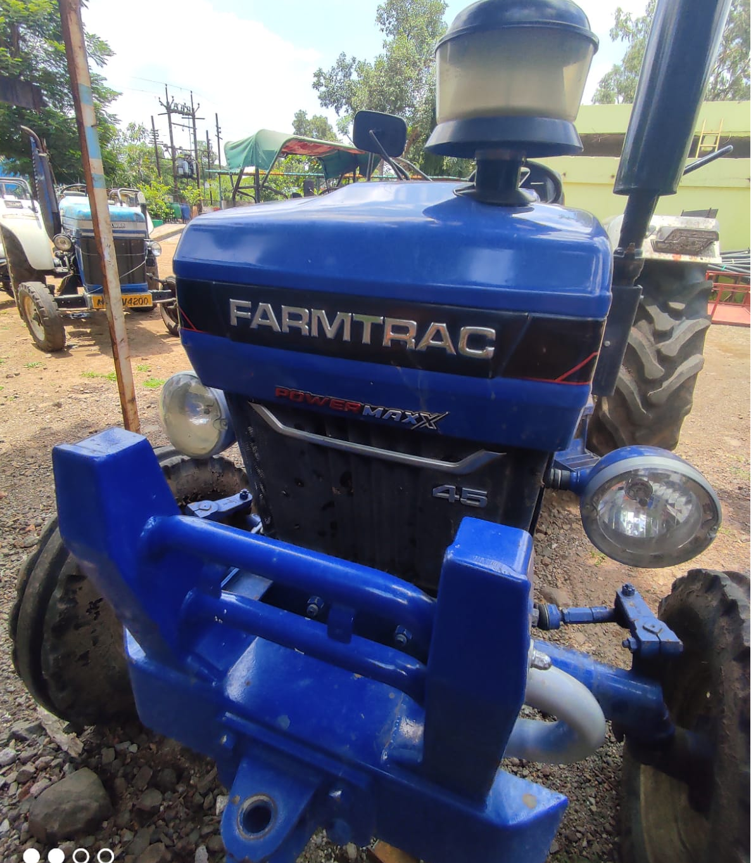
TRACTOR GALAXY

Slide 2
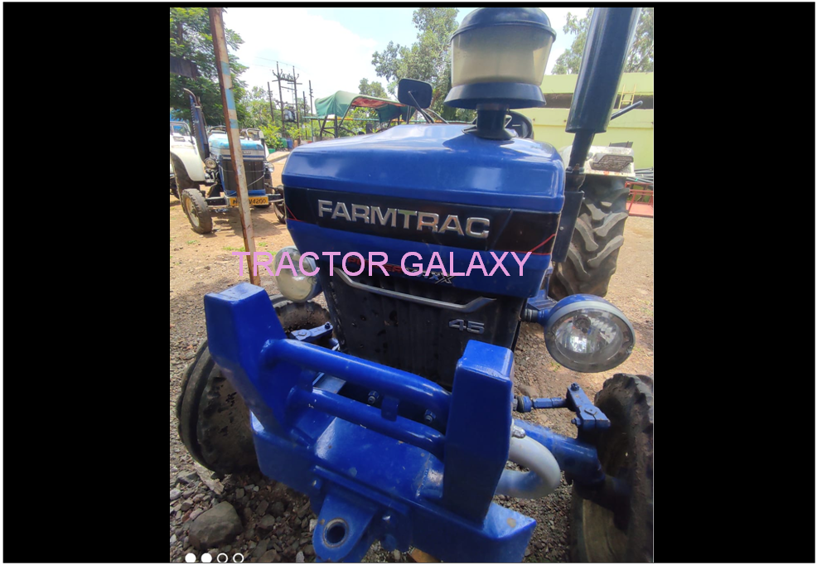

Slide 4
